Slide 1
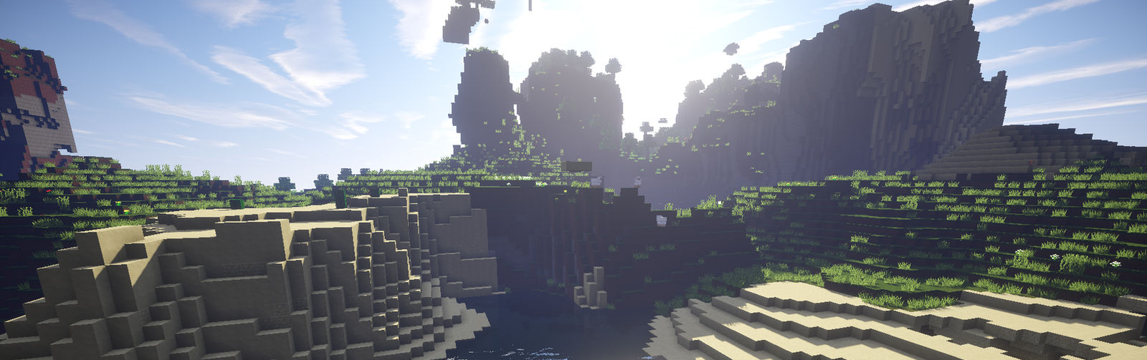
Co-Voyager: cooperative agents in the Minecraft environment

Slide 2
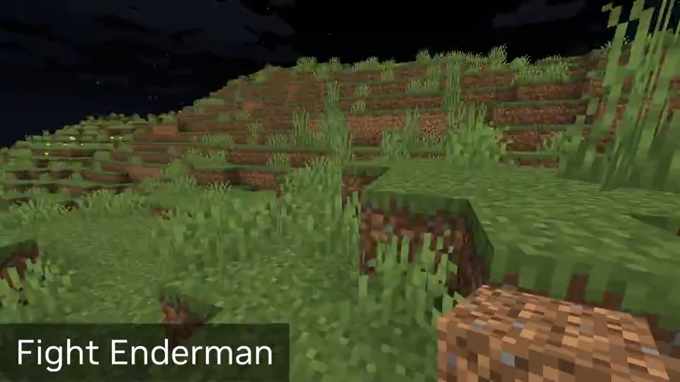
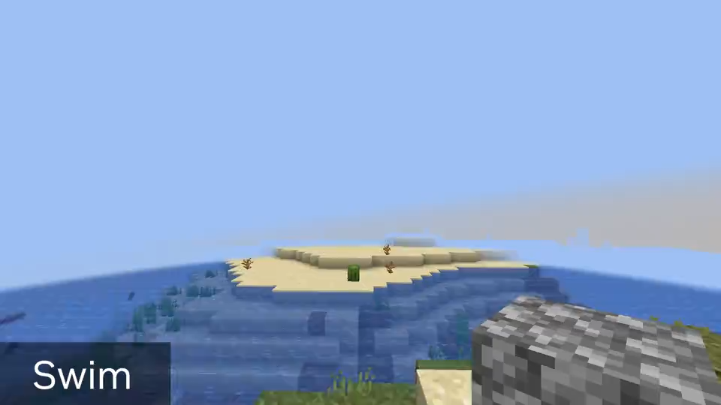

Voyager
It’s the first LLM-powered lifelong embodied learning agent in Minecraft that should have similar capabilities as human players:
Propose suitable tasks based on its current skill level and world state
Refine skill based on environmental feedback and commit mastered skill to memory for future usage
Continually explore the world

Slide 3
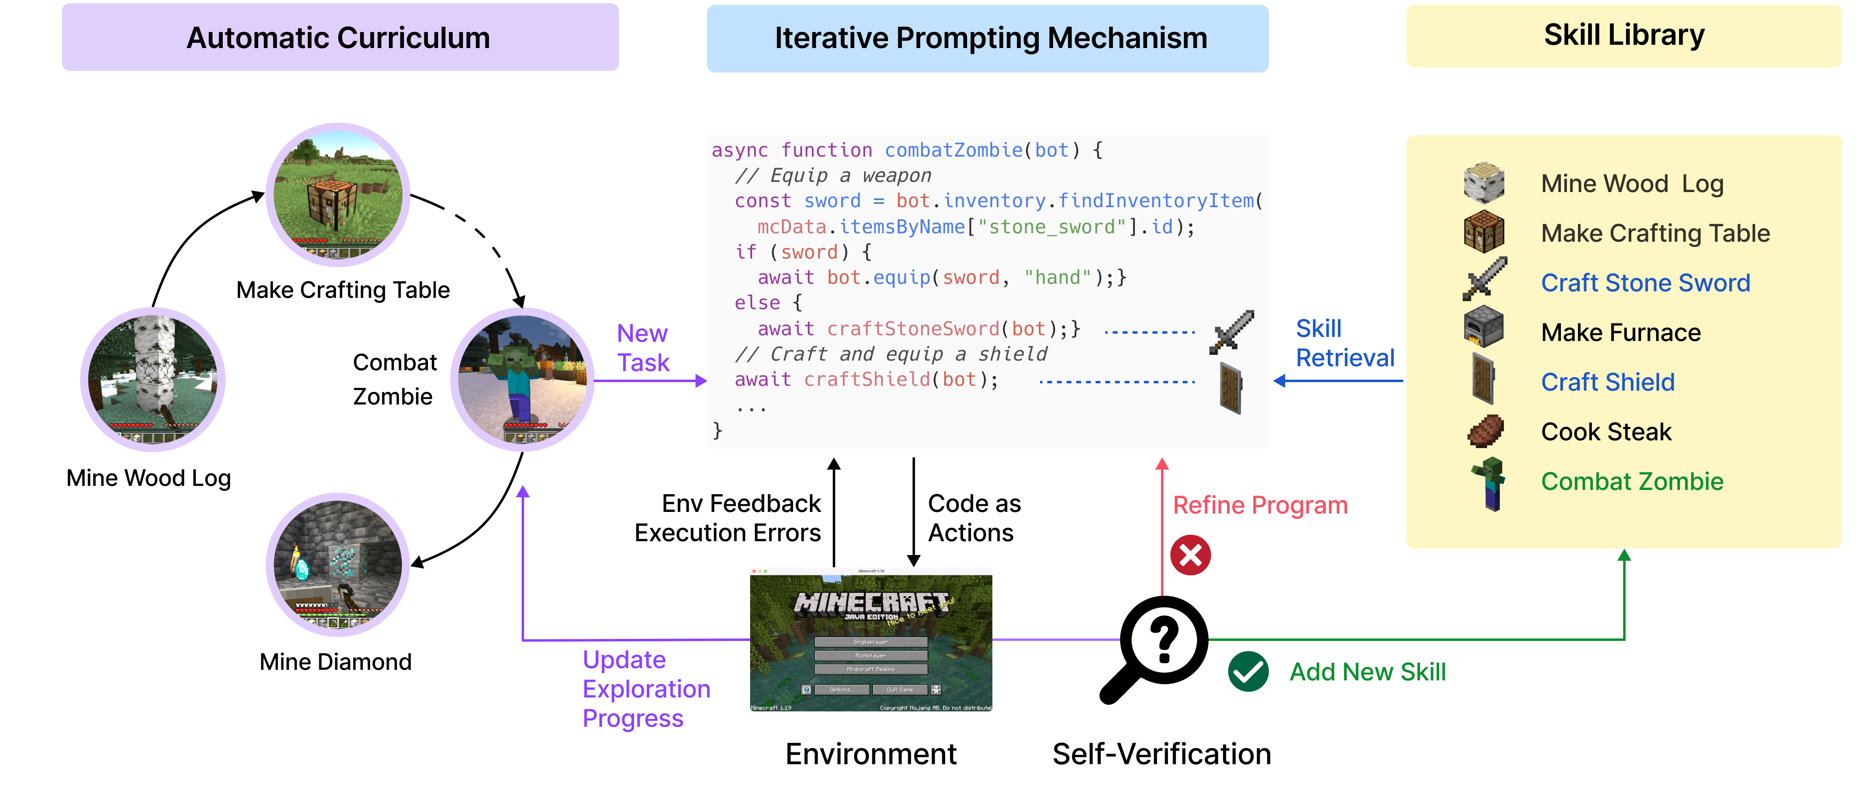
VOYager components

Slide 4
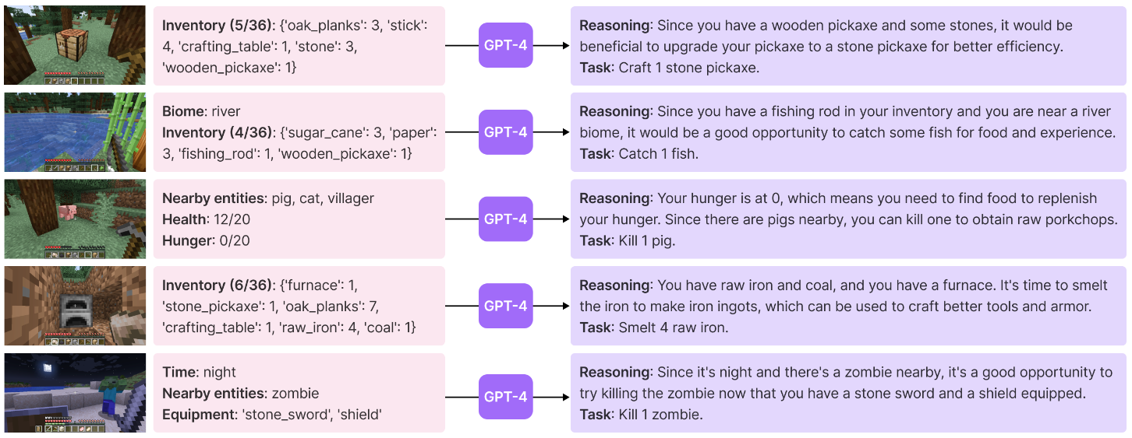
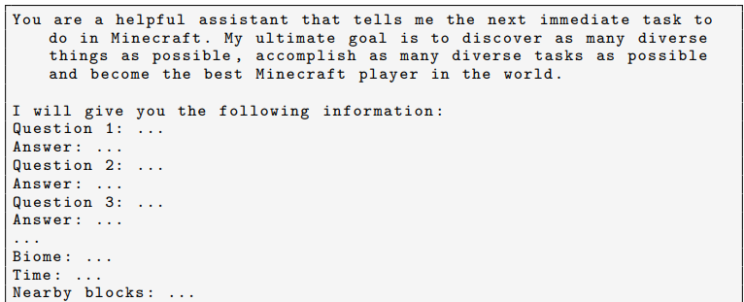
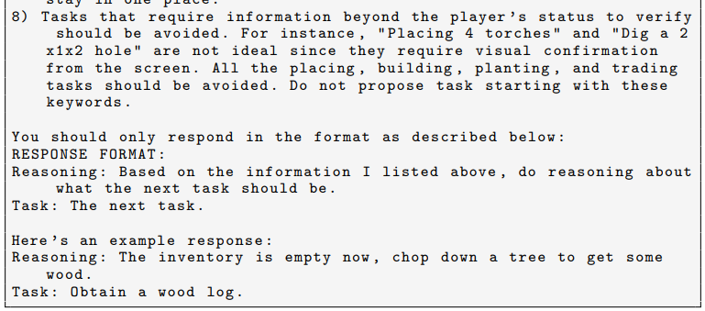
Automatic curriculum

Slide 5
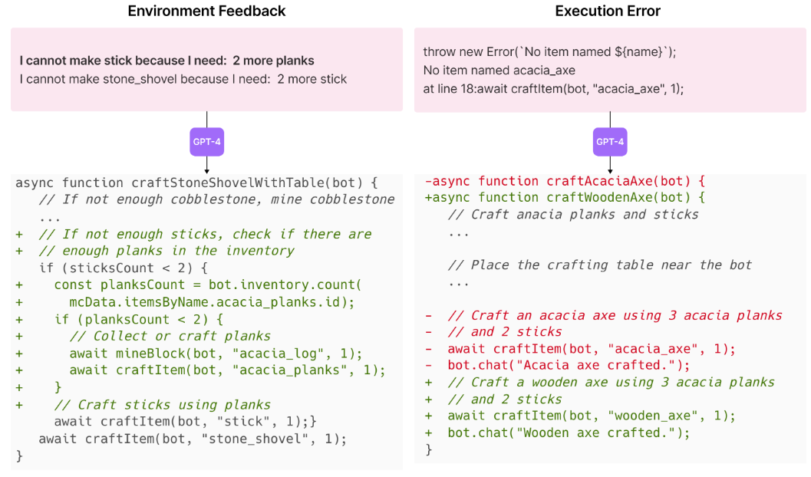
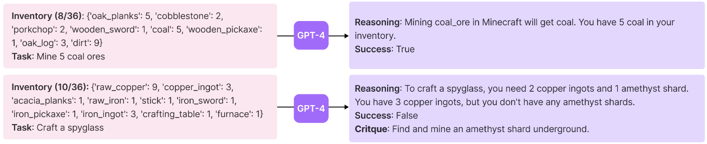
Iterative prompting mechanism

Slide 6
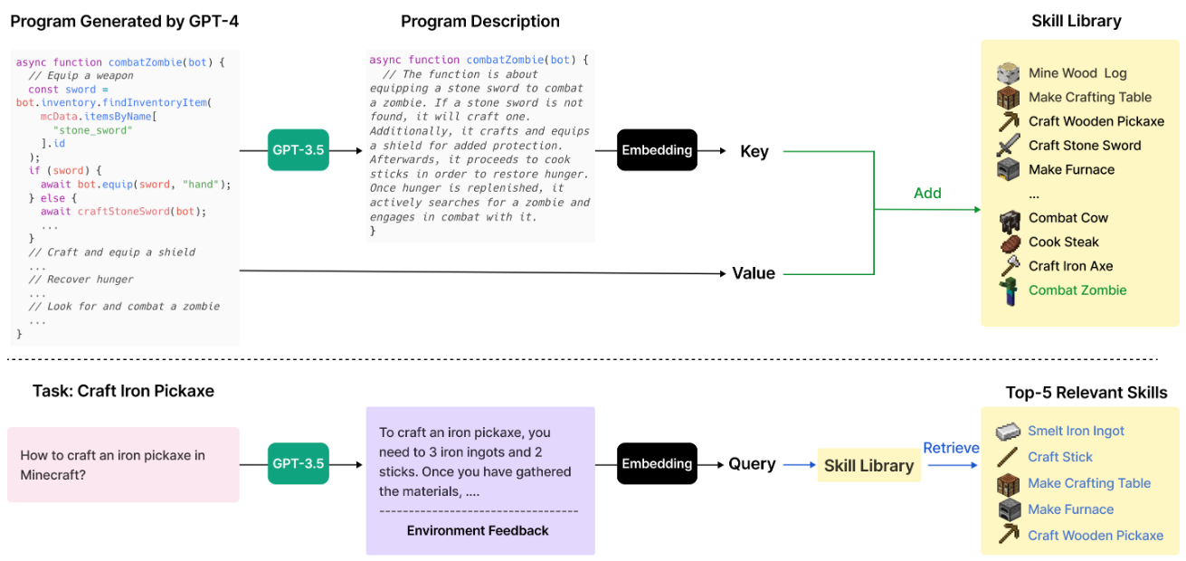
Skill retrieval

Slide 7
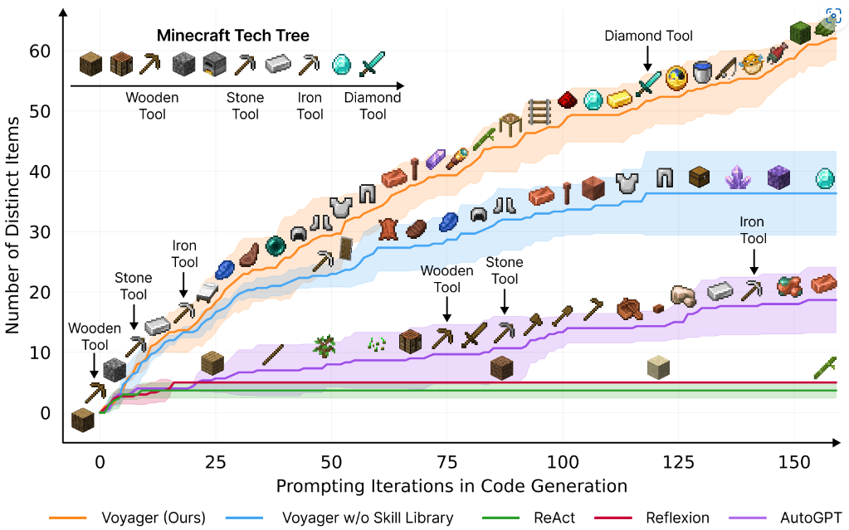
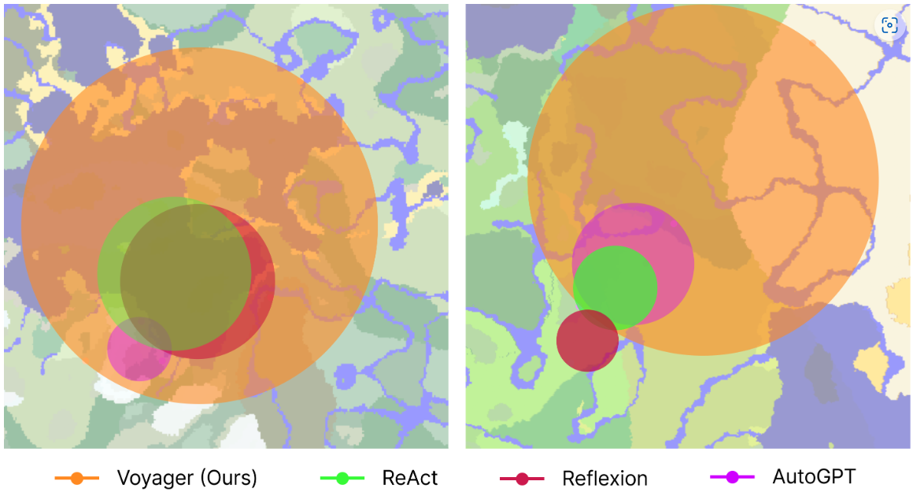
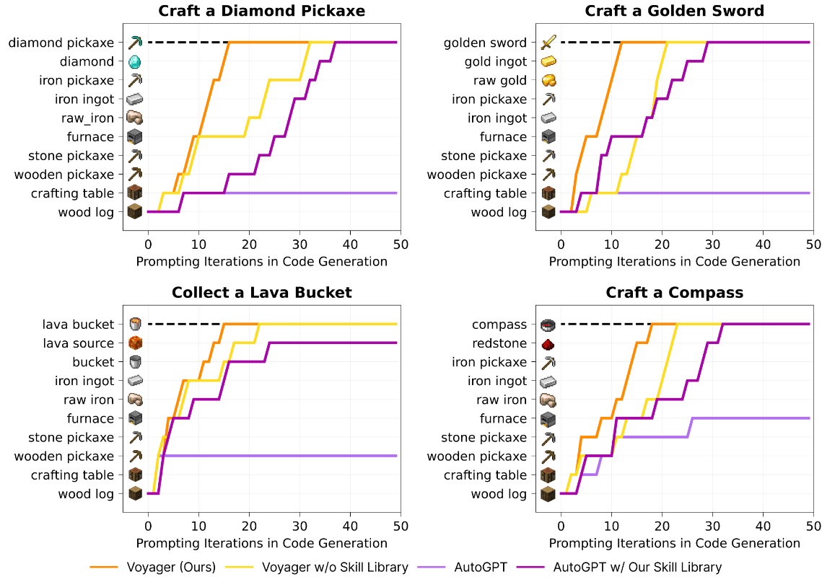
experiments

Slide 8
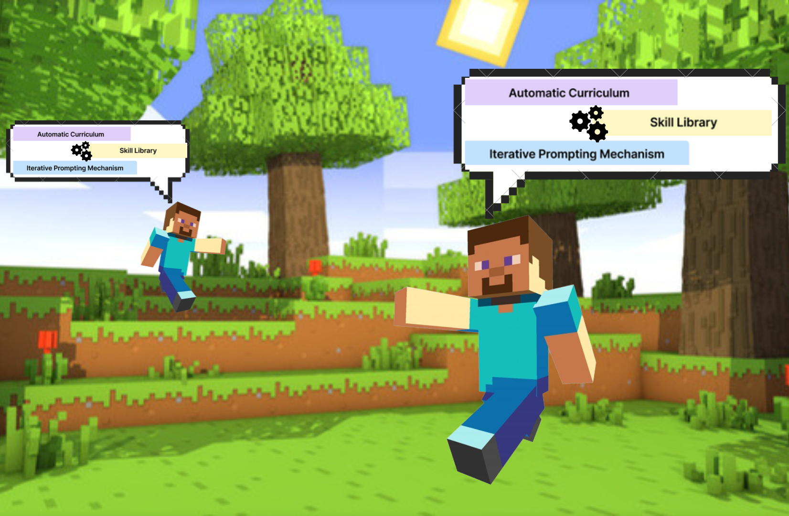
CO-VOYAGER
A minecraft environment with 2 (or more) embodied Voyager agents.
Goals:
make them cooperate towards specific tasks
Evaluate the cooperation abilities
Notes:
In 2005, Science Magazine judged the problem of “How Did Cooperative Behavior Evolve?” to be one of the top 25 questions “facing science over the next 25 years.”

Slide 9
Additional features we are going to add
Integration of Multiple Voyager Agents: Implementing several Voyager agents within a single Minecraft environment, allowing for simultaneous actions and interactions.
Task and Goal Specification: Defining clear, specific objectives that can be accomplished individually or through teamwork, offering varied challenges.
Agent Communication for Collaboration: Establishing communication protocols between agents, enabling them to interact either verbally or through actions, to coordinate and execute collaborative tasks effectively.
Performance Monitoring: Systems to track individual and joint performance, useful for later analysis and improvement.

Slide 10
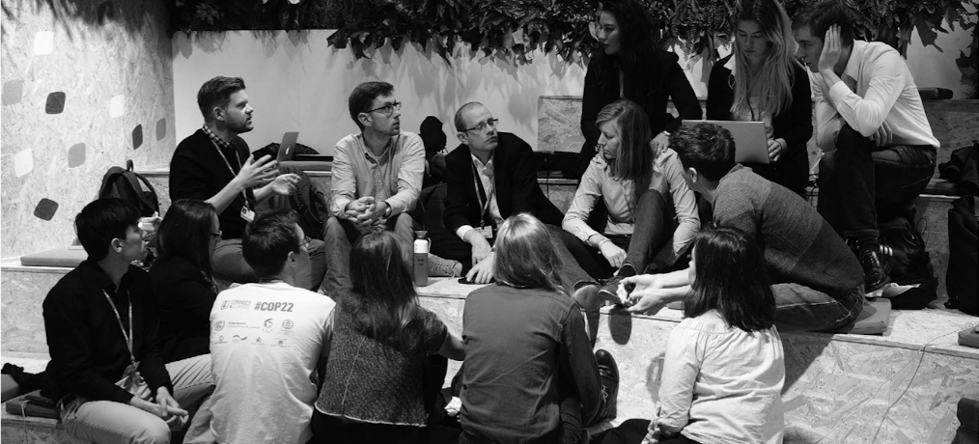
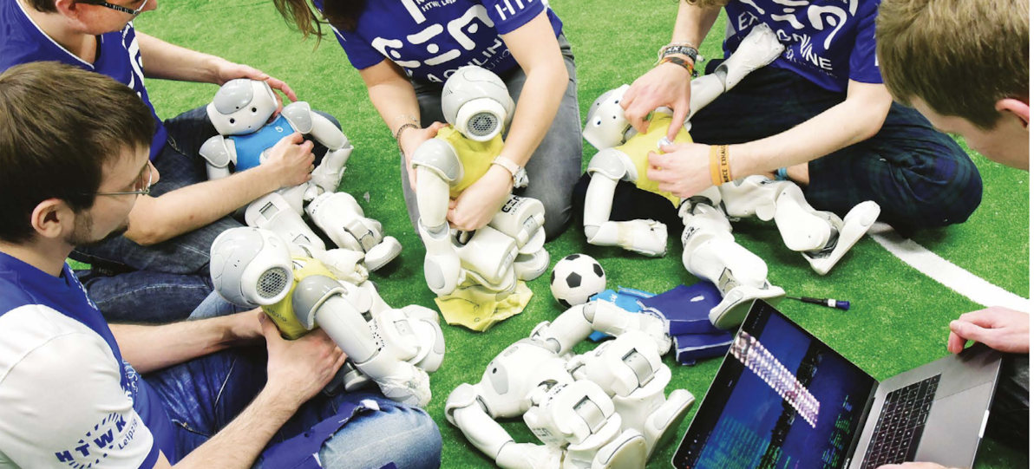
LITERATURE

Slide 11
Cooperative ai: machines must learn to find common ground
We need to build a science of cooperative AI
The AI community should learn more from other fields that works on cooperation
From autonomy to cooperation (self driving car)

Slide 12
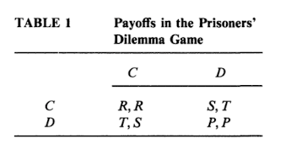
Axelrod’s the evolution of cooperation
Milestone paper in the cooperative science field
Has stated the need for a multidisciplinary approach
In the attempt solving the Prisoners’ Dilemma show how different approach can enrich ad ease the solution.

Slide 13
Open problems in cooperative ai
Highlight four key point to consider for enhancing the cooperation between AI:
Understanding: of other agents. Their beliefs, incentives and capabilities
Communication: between agents to overcome mistrust and deception
Commitments: to overcome incentives to renege
Institution: which can provide social structures to promote cooperation

Slide 14
WATCH-AND-HELP: A CHALLENGE FOR SOCIAL PERCEPTION AND HUMAN-AI COLLABORATION
AI systems lack at recognizing others goals and assisting them, so they:
develop AI agents with social perception and collaborative planning abilities
to test the social intelligence of AI agents
the metrics for the evaluation has inspired ours

Slide 15
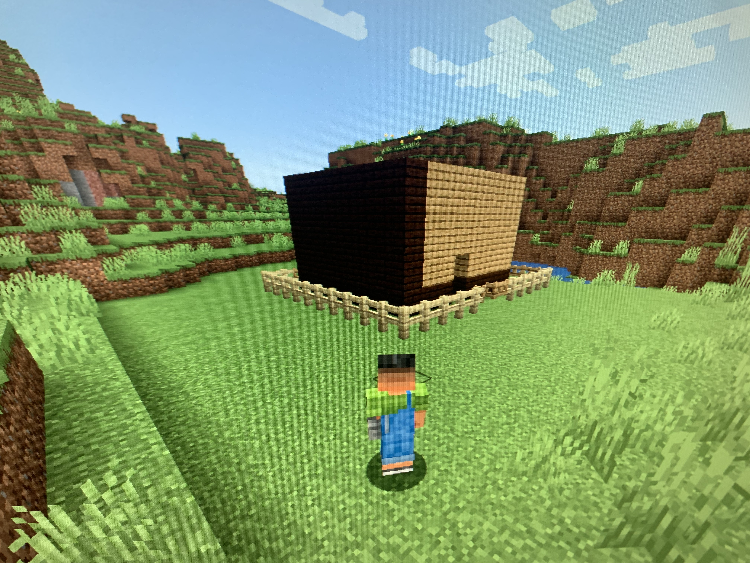
RQs & EXPERIMENTAL DESIGN

Slide 16
Research questions
-
D
I
F
F
I
CU
L
T
Y
+
RQ1: Are two agents , instructed with a different and specific goal, able to cooperate within each other toward the final goal?
→ Double Prompt task
RQ2: What is the capability of two or more agents to organize themself toward a final goal by assigning each some sub-goals?
→ Mono Prompt task
RQ3: How does the introduction of hierarchy in a multi-agents environment affect task completion?
→ Hierarchical task

Slide 17
Task 1: Building a house surrounded by a fence

Slide 18
Cooperation strategy 1: double prompt
Task: Building an 8x8 Blocks House
You're the guide for an embodied agent navigating Minecraft. Your task is to assist the agent in constructing an 8x8 blocks house within the game world. The agent has basic knowledge of Minecraft controls but lacks detailed construction skills.
Your prompts should cover:
Materials and Design: […]
Construction Steps: […]
Troubleshooting: […]
Enhancements: […]
Ensure your instructions are clear and concise, using Minecraft-specific [...] execute within the game's mechanics.
Task: Guiding the Agent in Building a Fence Around the 8x8 Blocks House
As the guide for the agents navigating Minecraft, your task is to assist in constructing a protective fence around the 8x8 blocks house, creating a 16x16 perimeter. The agent has basic knowledge of controls but may need guidance in the construction process.
Materials and Design: […]
Construction Steps: […]
Gate Access: [...]
Troubleshooting: [...]
Enhancements: [...]

Slide 19
Cooperation strategy 2: mono prompt
You and your partner are two embodied agents. Your shared goal is to construct a house surrounded by a fence within a designated area […]
The task requires teamwork, efficient resource allocation […] The focus lies not only on the successful completion of the house and fence but also on the cooperative dynamics demonstrated throughout the project.

Slide 20
cooperation strategy 3: Hierarchical
In this collaborative learning scenario, one agent acts as the knowledgeable teacher guiding the other, who takes on the role of a receptive trainee. Their shared goal is to build a house and fence […] Success hinges on effective communication […] collaborative efforts in completing the construction.
+
You’re the head
You’re the worker

Slide 21
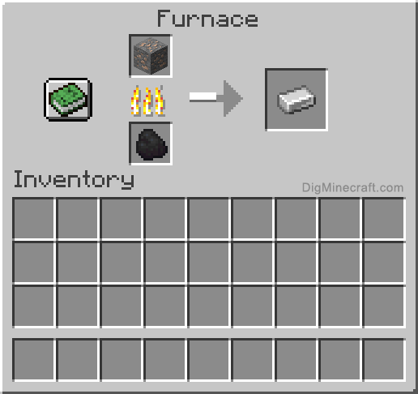
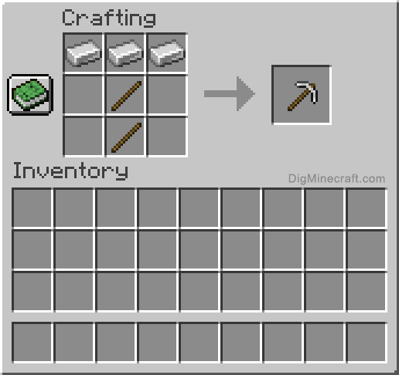
Task 2: Building an iron pickaxe
Agent_1
Agent_2
[this tool requires more technology than building a house]

Slide 22
Evaluation metrics
Quantitative:
In-game time (minutes)
Use of material (block)
Iterations with Gpt-4
Divided for each component
Iterations between agents
Qualitative:
Task completion
Correct and cooperative behavior
Efficiency of the communication
Ability to divide efficiently the task into sub-goal
Respect for the hierarchy

Slide 23
limitations
The main limitation are:
The cost, GPT-4 is quite expensive
A possible solution is to use Open LLMs (Mixtral-8x7B or Orca-2)
The literature on embodied cooperative AI it’s insufficient to predict if the experiment has a chance to work out
In general the field of cooperative AI it’s in development this very year, so currently there’s a lack of metrics and results in that we can base on

Slide 24
links
mistralai/Mixtral-8x7B-v0.1 · Hugging Face
microsoft/Orca-2-7b · Hugging Face
Voyager | An Open-Ended Embodied Agent with Large Language Models (minedojo.org)
MineDojo | Building Open-Ended Embodied Agents with Internet-Scale Knowledge

Slide 25
References
Puig, X., Shu, T., Li, S., Wang, Z., Liao, Y. H., Tenenbaum, J. B., ... & Torralba, A. (2020). Watch-and-help: A challenge for social perception and human-ai collaboration. arXiv preprint arXiv:2010.09890.
Dafoe, Allan, et al. "Open problems in cooperative AI." arXiv preprint arXiv:2012.08630 (2020).
Milgrom, P. R. (1984). Axelrod's" The Evolution of Cooperation".

